Slide 1
Context-aware management of e-services
(Tempura reengineering)
Vladimir Valkanov
University of Plovdiv

Slide 2
DeLC Project
Main goal: delivering e-services to support e-learning;
DeLC architecture: distributed system, containing fixed and mobile nodes;
Mobile node: providing mobile access to the services, through intelligent wireless network based on InfoStation architecture;

Slide 3
Infrastructure of DeLC

Slide 4
Mobile node middleware

Slide 5
Main goal
To expand the middleware with intelligent agents, which are able to detect and manage time aspects of delivering educational services and content in distributed InfoStation network.

Slide 6
Tasks
To investigate and specify time aspects of the mobile node
Choose a proper formalism to manage the time components in the system
To find a proper approach for realisation
To create architecture
To create a prototype
To integrate in DeLC

Slide 7
Time aspects
Scenarios
  They specify the functionality of our communication environment (InfoStations)
During the execution of a service different local events could happened :
  Getting in range of an IS
  Getting out of range of an IS
  Change the mobile device
The existing middleware could react to various events, but he is unable to represent them in time order.
  No management mechanism
In the scenario point of view the problem is to manage scenario change and execution

Slide 8
Choosing a proper formalism
Interval Temporal Logic (ITL)
  Ben Moszkowski – Computer Laboratory, University of Cambridge
What is ITL:
  First order logic with added time dependent operators like “sometimes” , “always”, “next” …
  Considering time as a discrete sequence of points in time called intervals
  For ITL there is an interpreting mechanism and its program realisation called Tempura.

Slide 9
Tempura
Imperative programming language which use subset of ITL:
  First interpreter was written in Prolog
  Current version:
    Roger Hale, Ph.D. thesis in Cambridge , 1984-1985 г., C
  Maintenance: Antonio Cau, STRL, De Montfort University
AnaTempura
  The centralize surrounding environment of Tempura

Slide 10
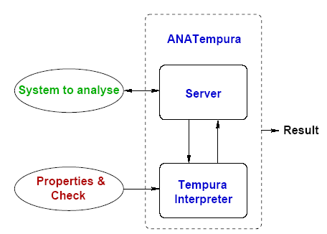
AnaTempura

Slide 11
Approach
Three possible ways:
  Wrapping Tempura with I/O Java classes
  Creating a complete new Java version of ITL interpreter
  Reengineering the existing C-based version of Tempura

Slide 12
Why reengineering?
Missing documentation and specification of the basic algorithms used in the interpreter
Homogeneous environment
Using proven system and already prepared test cases

Slide 13
Reengineering in steps
Iterative hand-made translation
  C to Java without changing the imperative structure of the system
  Imperative Java to OO Java
  OO Java to AO Java (JADE)

Slide 14
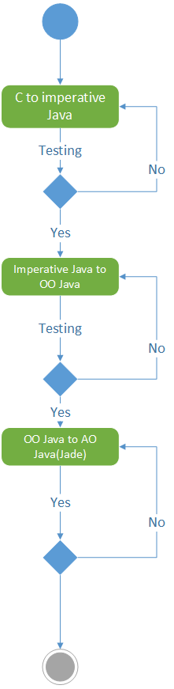
Approach schema

Slide 15
Schema of the original Tempura C-code

Slide 16
Schema of OO Java version

Slide 17
Prototype
Imperative Java interpreter
  Standard Test Suite
ОО Java interpreter
  Extended Test Suite , received from STRL

Slide 18
AO Java interpreter
Possibilities
  Transform the interpreter in a single agent
  Or multi-agent system
InfoStation middleware
  To substitute AnaTempura
  Decentralized delivery of attribute values ​​from the environment
Development framework
  JADE
BDI architecture
  BDI4JADE plug-in

Slide 19
Package suggestion

Slide 20
Transform into package structure

Slide 21
AO Tempura life-cycle suggestion

Slide 22
Next steps
Realisation of an AO Java interpreter prototype
Integration into DeLC agent middleware
Testing in real DeLC environment

Slide 23
THANK YOU FOR YOUR ATTENTION

